Slide 1
Branch County:
Trends and Random Thoughts about the Future
George A. Erickcek
W.E. Upjohn Institute for Employment Research
February 29, 2008

Slide 2
Agenda
Analysis of Branch County’s economy
  Sluggish economic conditions
  A long-term forecast for the same due to statewide conditions
Thoughts about the future
  Importance of manufacturing
  What about emerging industries?
  What if it’s human capital that is the new driver?
  Possible role of retirees

Slide 3
Thoughts on Economic Development
The very essence of long-run growth is, in fact, the transition …from one export base to another as the area matures in what it can do, and as rising per capita income and technological progress change, what the world economy wants done.
Local economic development activities should be focused on bringing economic opportunity to current underemployed and unemployed residents.

Slide 4
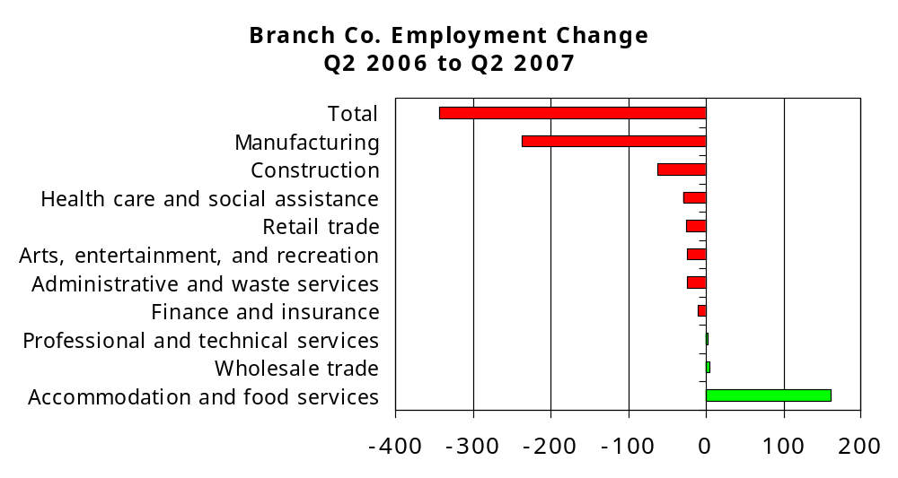
Branch County lost jobs in 2006-2007, and it was across many sectors.
Source: MDLEG, ES-202 employment data.

Slide 5
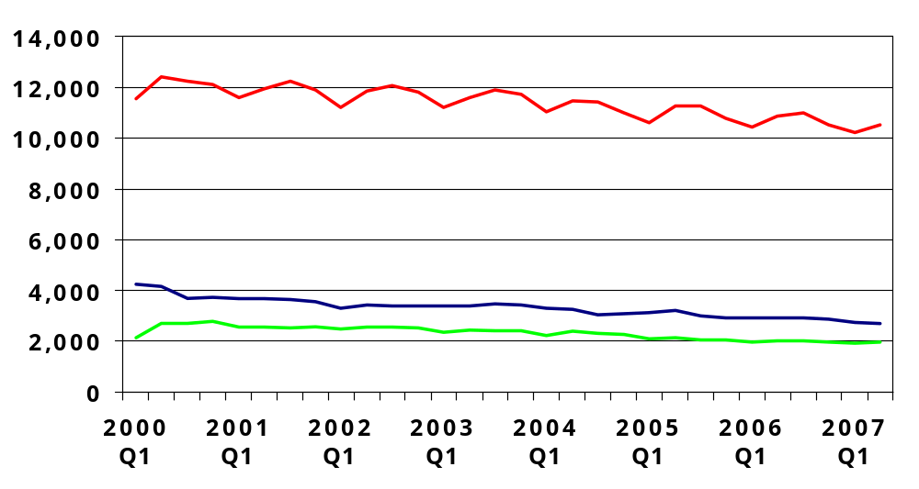
Employment levels in the county have been stagnant, at best, during the last six years.
Source: MDLEG ES-202 quarterly employment data and BLS LAUS employment by residence.

Slide 6
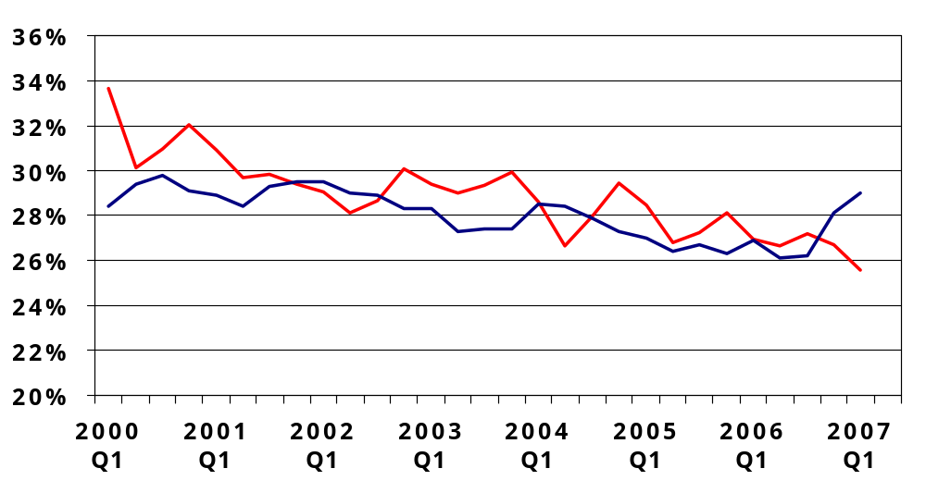
Manufacturing and the county’s hospitality and retail sectors were “locked stepped” until 2007.
Manufacturing
Hospitality & Retail
Source: MDLEG ES-202 quarterly employment data and BLS LAUS employment by residence.

Slide 7
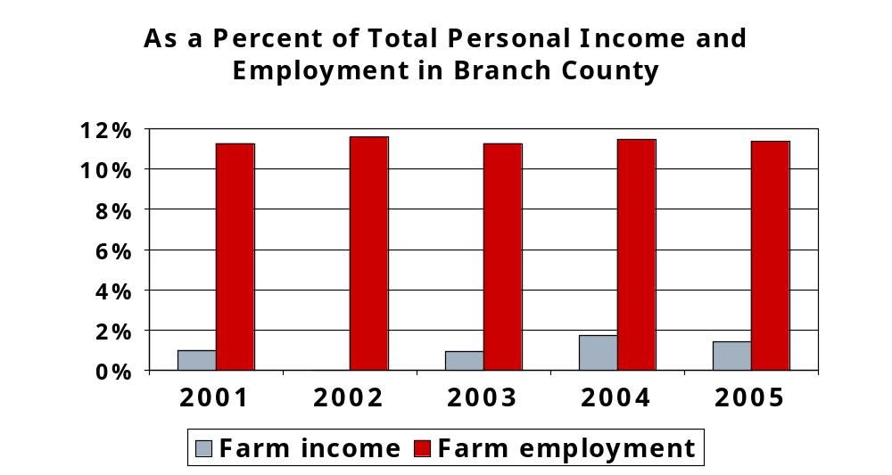
Farm employment – Holding steady
Source: BEA-REIS

Slide 8
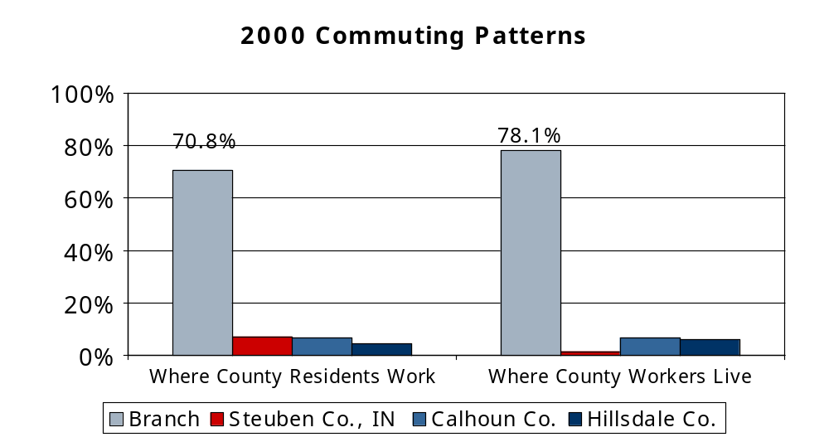
For the most part, Branch County residents work in the county.
Source: 2000 Census.

Slide 9
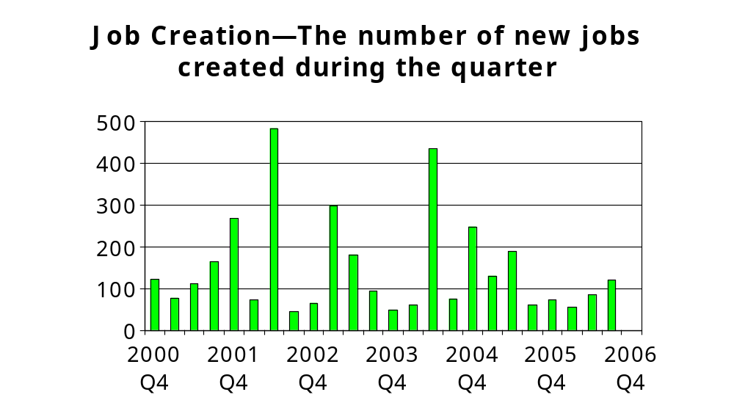
However, it is key to note that the county’s manufacturers have been creating jobs.
Source: MDLEG LHED Excludes recalls and replacement hires.

Slide 10
Long-term forecast for Branch County: 2007 to 2017
Assumptions:
National economy:
0.9% ann. avg. employment growth
2.6% ann. Avg. GDP growth
State assumptions:
Detroit will lose 1.4% annually in mkt share

Slide 11
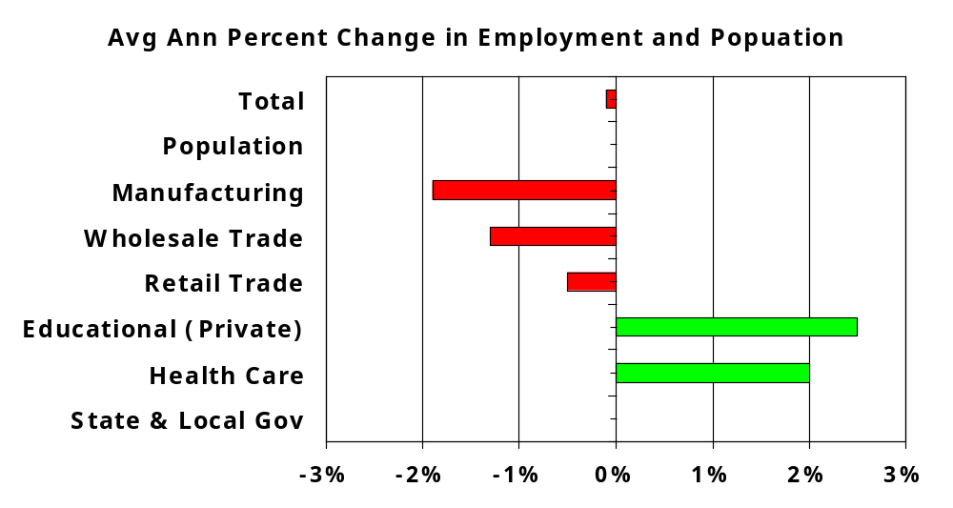
Forecast: Little growth expected
But, this is not written in stone.
Source: W.E. Upjohn Institute

Slide 12
Thoughts about the Future
Manufacturing matters.
Targeting emerging industries is another name for gambling.
Increasingly, growth will come from within.
What will the role of retirees be in economic development?

Slide 13
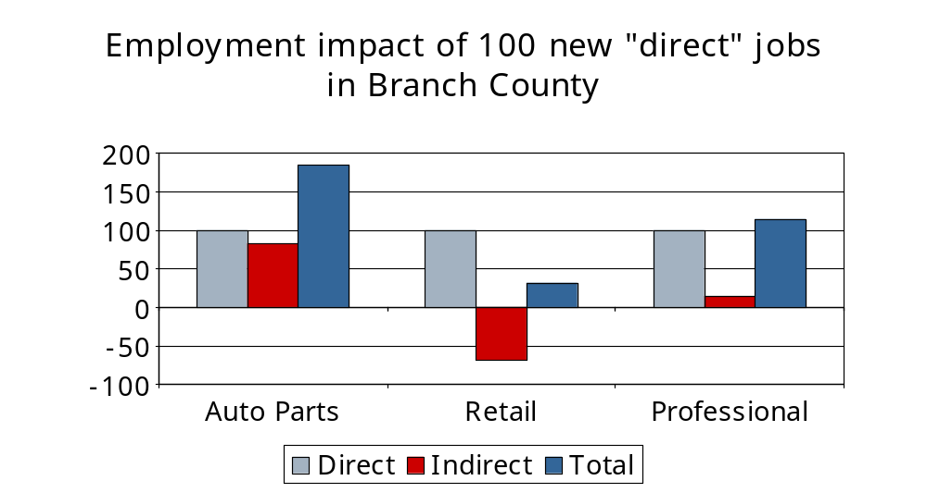
Employment impact of new jobs— manufacturing swings a big bat.

Slide 14
Thoughts on Manufacturing
The region’s manufacturing sector can and will be the source of new products and processes.
  Productivity improvements will hold down employment gains.
  Skill requirements will only increase.
  Routine production will continue to leave.
  HOWEVER, manufacturing will remain as the region’s major strength and economic base.

Slide 15
The Challenge Facing Many Manufacturers
Automate, Emigrate, or Evaporate
In short, the global economy has made many regional inputs ubiquitous.
Some would argue that these are the choices facing U.S. traditional industries, and this is why we must look to emerging industries.

Slide 16
I disagree.
Most research suggests that healthy firms and their clusters are the incubators for new ideas and products.
There is greater potential in manufacturing for the creation of job chains which can reach the unemployed and underemployed.

Slide 17
Success depends on identifying interaction of three key elements of regional economies:
Global Factors
Demographic change
Environmental
Political/Social
Technological Change
Applications
Feasibility
Survivability
Regional Structure
Export Base activities across all industries
Non-Export Base activities

Slide 18
Global Factors
Demographic shift:
  Aging population in developed countries
  Growing and young population in the developing countries
Growth areas are outside of the U.S.
Growing environmental concerns:
  Energy shortages
  Impact of global warming
Political unrest in developing countries

Slide 19
Technological Change
Rapid shifts in competing technologies:
  Promising technologies can be eclipsed quickly by better technologies .
  The more powerful technologies cross traditional industrial lines.
  Many technologies are not feasible or marketable.
  Technology change in industry is likely
  to occur in cluster locations.

Slide 20
Regional Structure
To grow, the region must expand its export base.
All industries generate “export” activities. It is not limited to manufacturing.
Import substitution is a related path that holds promise.
Export success relies on four factors:
Competitiveness
Innovation
Industrial Mix
Amenities

Slide 21
Emerging Industry Opportunities
Adapt new technology in product development at existing companies
Usual suspects for emerging industry targets
Technological Change
Regional
Structure
Global Factors
Development of new markets for existing businesses

Slide 22
Theoretical approaches to economic development
Spatial effects of product cycles
Economic networks
Are there any practical implications?

Slide 23
The county’s economic future is dependent on the “age” of its exporters.
Stage 1: Birth—An environment of entrepreneurship
Stage 2: Product development and wealth creation—An environment for success
Stage 3: Product standardization— Low cost, competitive environment
Stage 4: Death—An environment of abandonment

Slide 24
Thoughts on regional networks
Presence of local supply linkages
. . .
. . .
. . .
. . .
Presence of internal integration
Absence of internal integration
. . .
. . .
. . .
Absence of local supply linkages
Source: Maillat & Grosjean Globalisation and Territorial Production Systems in Fischer et.al. Innovation, Networks and Localities

Slide 25
Thinking Differently About Economic Development—Human Capital
What if:
  Human capital not physical capital will be the new dominant factor for growth:
    Tax abatements lose their value.
    Government services become more important—good schools, safe streets.
    Recreational/cultural opportunities.
    And, unfortunately urban places do better than rural areas in attracting talent.

Slide 26
Talent is tied to the firm’s product’s life cycle
Stage 1: Birth—An environment of entrepreneurship—High Talent
Stage 2: Product development and wealth creation—An environment for success—High Talent
Stage 3: Product standardization— Low cost, competitive environment—Medium-to-low Talent
Stage 4: Death—An environment of abandonment—Loss of Talent

Slide 27
What about retirees?
A boost to the county’s retail and health sectors.
Can improve community leadership and social involvement.
However,
Can put added stress on social services—public and private.
Many of the jobs will likely be part-time and low-wage.

Slide 28
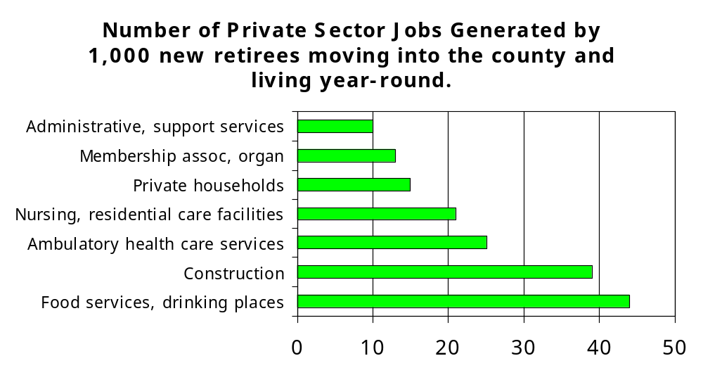
Attracting retirees will generate jobs.

Slide 29
Branch County
Trends and Random Thoughts about the Future
George A. Erickcek
W.E. Upjohn Institute for Employment Research
February 29, 2008
erickcek@upjohninstitute.org

